Slide 1
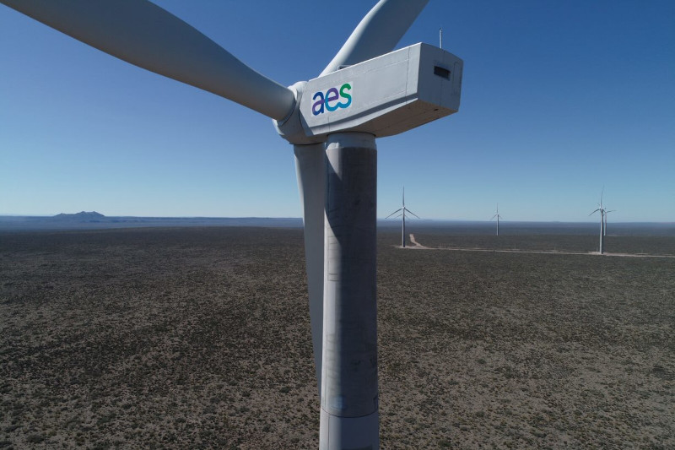

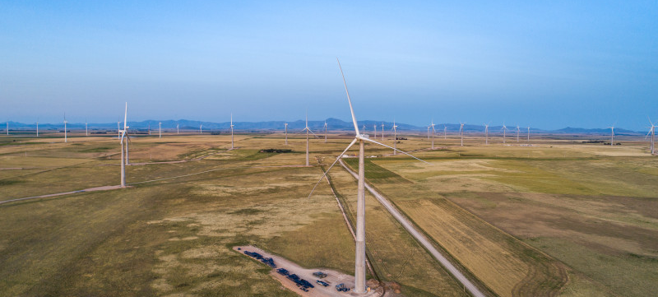
Air Quality
AES Argentina
April2026
Notes:
Cover page opt 2

Slide 2
Saavedra Station
No values ​​above the legal limit were observed. The PM10 and PM2.5 equipment was removed and a replacement is pending..

Slide 3
UTN Station
No values ​​above the legal limit were observed.

Slide 4
San Nicolas Thermal Power Plant
On 1/04, NOx values ​​above the limit were observed, corresponding to equipment calibration.

