Slide 1
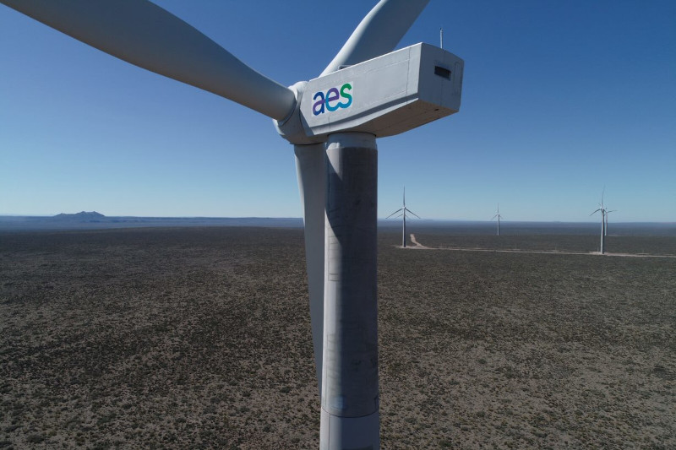

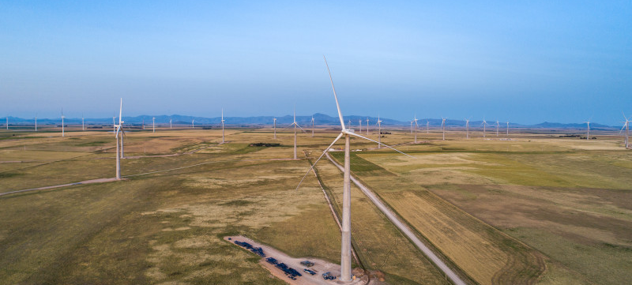
Air Quality
AES Argentina
July 2026
Notes:
Cover page opt 2

Slide 2
Saavedra Station
No values ​​above the legal limit were observed. The PM10 and PM2.5 equipment was removed and a replacement is pending.

Slide 3
UTN Station
One day was observed above the legal NOx limit corresponding to the calibration day (1/07)

Slide 4
San Nicolas Thermal Power Plant
NOx and SO2 values ​​above the legal limit were observed, corresponding to calibration days (1 and 31/07)

